Slide 1
Docker 101

Slide 2
1. Introduction

Slide 3
The Birth of Docker

Slide 4
The Promise of Docker
Benefits of the Docker Workflow

Slide 5
What Docker Ins’t

Slide 6
2. Docker at a Glance

Slide 7
Process Simplification

Slide 8
Broad Support and Adoption

Slide 9
Architecture
Client / Server Model
Network Ports and Unix Sockets
Robust Tooling
Docker Command-Line Tool
Application Programming Interface (API)
Container Networking

Slide 10
Getting the Most from Docker
Containers are not Virtual Machines
Containers are Lightweight
Towards an Immutable Infrastructure
Limited Isolation
Stateless Applications
Externalizing State

Slide 11
The Docker Workflow
Revision Control
Building
Testing
Packaging
Deploying
The Docker Ecosystem

Slide 12
Wrap-Up

Slide 13
3. Installing Docker

Slide 14
Important Terminology

Slide 15
Docker Client
Linux
Mac OS X 10.10
Microsoft Windows 8

Slide 16
Docker Server
Systemd-Based Linux
Upstart-Based Linux
init.d – Based Linux
Non-Linux VM Based Server

Slide 17
Test the Setup
Ubuntu
Fedora
CentOS

Slide 18
Wrap Up

Slide 19
6. Working with Docker Images

Slide 20
Anatomy of a Dockerfile

Slide 21
Building an Image

Slide 22
Running Your Image
Environment Variables

Slide 23
Custom Base Images

Slide 24
Storing Images
Public Registries
Private Registries
Authenticating to a Registry
Mirroring a Registry
Other Approaches to Image Delivery

Slide 25
7. Working with Docker Containers

Slide 26
What are Containers ?
History of Containers

Slide 27
Creating a Container
Basic Configuration
Storage Volumes
Resource Quotas

Slide 28
Starting a Container

Slide 29
Auto-Restarting a Container

Slide 30
Auto-Restarting a Container

Slide 31
Stopping a Container

Slide 32
Auto-Restarting a Container

Slide 33
Stopping a Container

Slide 34
Killing a Container

Slide 35
Pausing and Unpausing a Container

Slide 36
Cleaning Up Containers and Images

Slide 37
Next Steps

Slide 38
8. Exploring Docker

Slide 39
Printing the Docker Version

Slide 40
Server Information

Slide 41
Downloading Image Updates

Slide 42
Inspecting a Container

Slide 43
Getting Inside a Running Container
docker exec
nsenter

Slide 44
Exploring the Shell

Slide 45
Returning a Result

Slide 46
Docker logs

Slide 47
Monitoring Docker
Container Status
Docker Events
cAdvisor

Slide 48
9. The Path to Production Containers

Slide 49
Deploying
Classes of Tooling
Orchestration Tools
Distributed Schedulers
Deployment Wrap-Up

Slide 50
Testing Containers
Quick Overview
Outside Dependencies

Slide 51
10. Debugging Containers

Slide 52
Process Output

Slide 53
Process Inspection

Slide 54
Controlling Processes

Slide 55
Network Inspection

Slide 56
Image History

Slide 57
Inspecting a Container

Slide 58
Filesystem Inspection

Slide 59
Moving Along

Slide 60
11. Docker at Scale

Slide 61
Docker Swarm

Slide 62
Centurion

Slide 63
Amazon EC2 Container Service
IAM Role Setup
AWS CLI Setup
Container Instances
Tasks
Testing the Task
Stopping the Task

Slide 64
Wrap Up

Slide 65
12. Advanced Topics

Slide 66
Pluggable Backends
Execution Drivers
Storage

Slide 67
Containers in Detail
Control Groups (cgroups)
Kernel Namespaces, User Namespaces

Slide 68
Security
How Secure is your container ?
How Secure is the Docker Daemon ?

Slide 69
Networking

Slide 70
13. Designing your production container platform

Slide 71
The Twelve-Factor App
Codebase
Dependencies
Config
Backing Services
Build, Release, Run
Processes
Port Binding
Concurrency
Disposability
Development/Production Parity
Logs
Admin Processes
Twelve-Factor Wrap-Up

Slide 72
The Reactive Manifesto
Responsive
Resilient
Elastic
Message Driven

Slide 73
14. Conclusion

Slide 74
The Challenges

Slide 75
The Docker Workflow

Slide 76
Minimizing Deployment Artifacts

Slide 77
Optimizing Storage and Retrieval

Slide 78
The Payoff

Slide 79
The Final Word

Slide 80
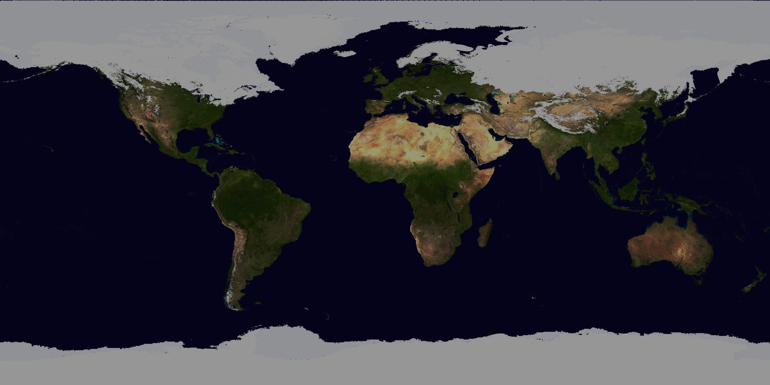
World population
2048
9 bin
2012
7 bin
2024
8 bin
1999
6 bin
1987
5 bin
1974
4 bin
1960
3 bin
1804
1 bin
1927
2 bin
1700
1800
1900
2000

Slide 81
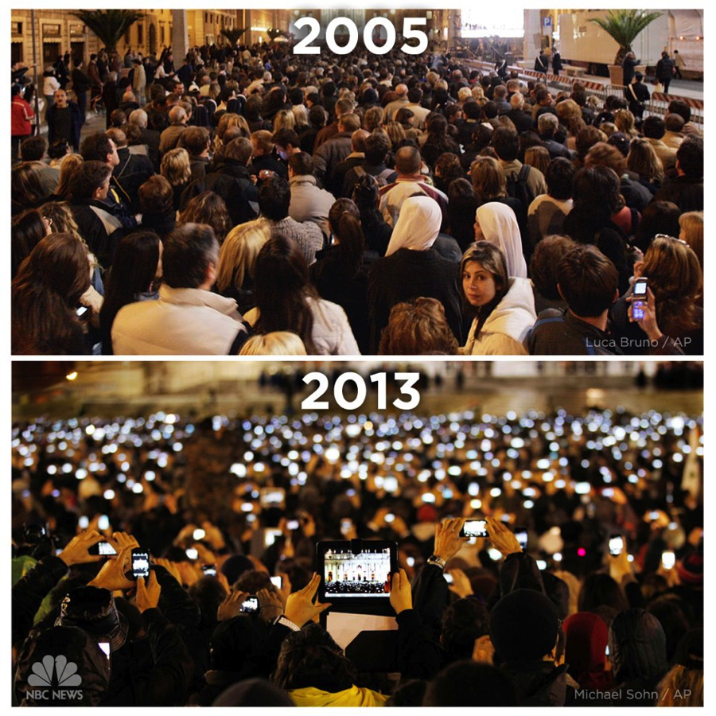

Slide 82
Growth of devices

Slide 83
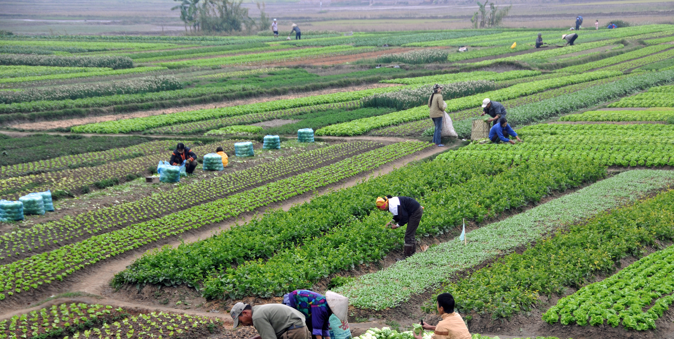
Agriculture

Slide 84
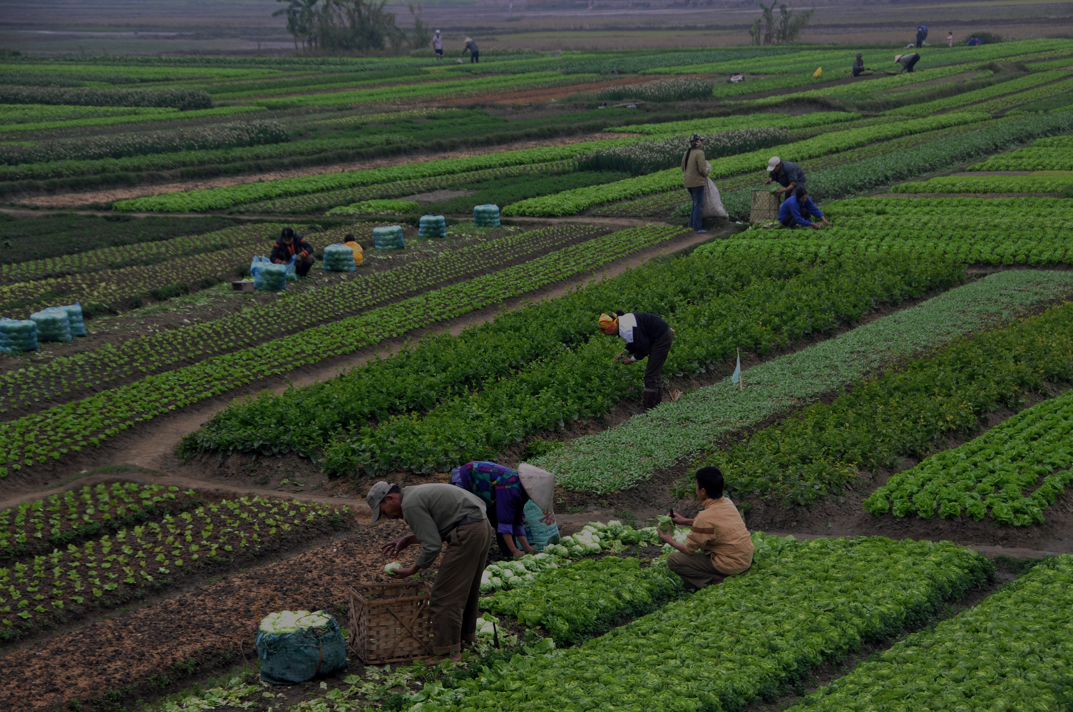
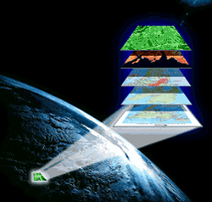
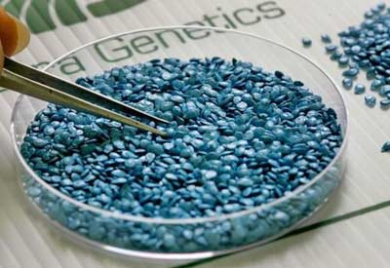
Agriculture: increase production
Satellite Imagery
Enhanced Seed Engineering

Slide 85

banking

Slide 86



banking: increase production
Transaction Processing
Identify, Sourcing, Pricing, Selling or Retaining Risk

Slide 87

transportation

Slide 88


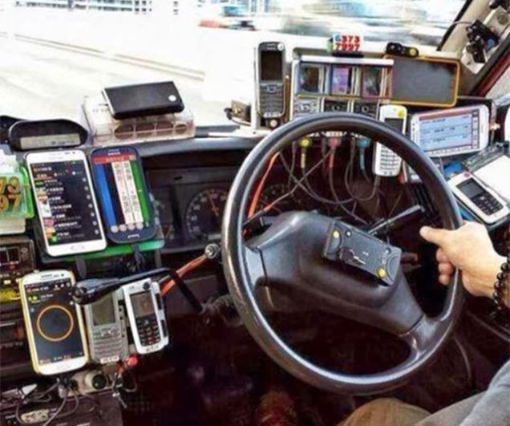
Taxi: better information
Finding the closest taxi
Finding the closest user

Slide 89
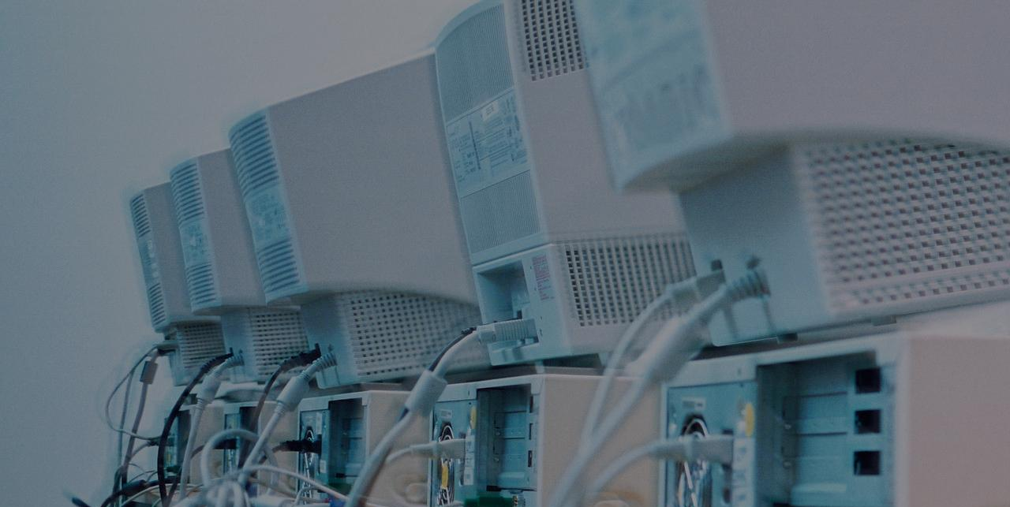
The evolution of it in businesses
The “IT” guy
IT Manager
C.T.O.
(Chief Technology Office)

Slide 90
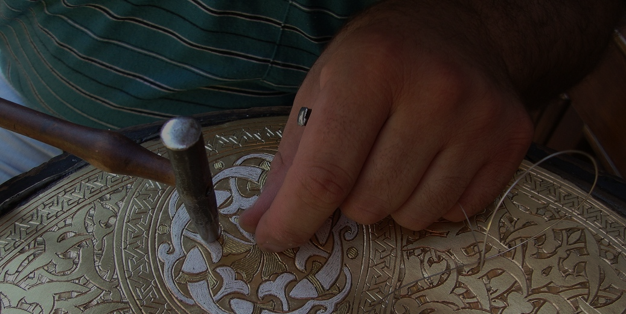
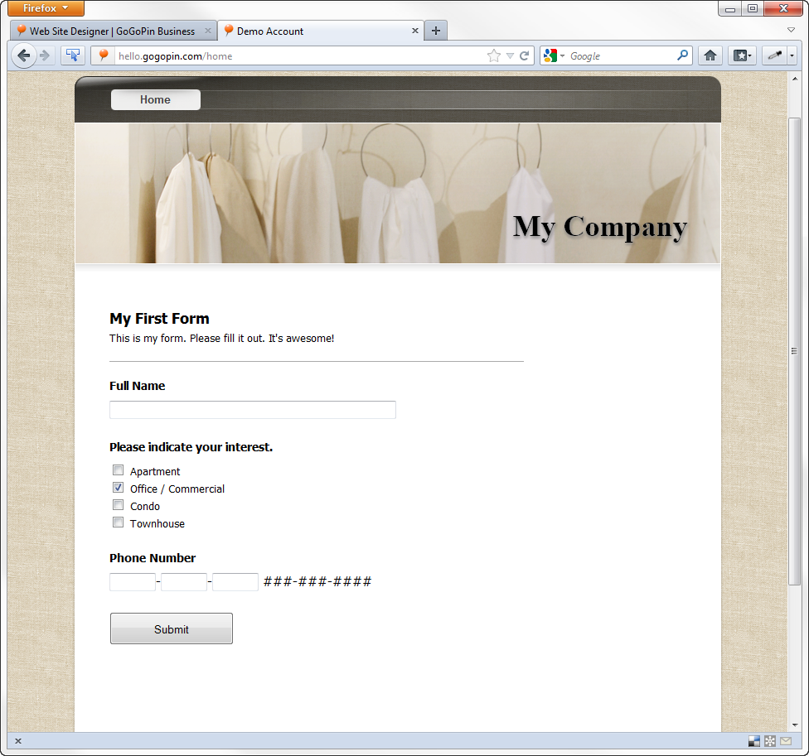
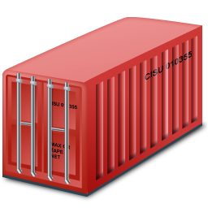



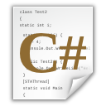


Traditional iT
Business
Operations
Development

Slide 91
Traditional iT
1 Deployment
(in production)
6 Months
(aprox)

Slide 92




Traditional iT: development
Old Code
Pending Code
Monolith
Construction
New
Product
New Features

Slide 93


Traditional iT: development
Development Enviroment
Production Environment

Slide 94


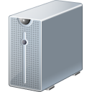


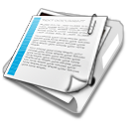
Traditional iT: operations
Constant Growing Number of Servers
Ineffective tooling to administer
Problems in releasing new code into production
Scheduling and burocreacy
Responsible for diagnose problems

Slide 95

The conflict
developers
operations

Slide 96

DEVOPS integrates developers and operations teams in order to improve collaboration and productivity by automating infrastructure, workflows and continuously measuring application performance.

Slide 97
Business
DevOps

Slide 98
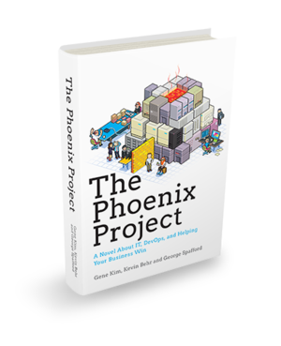
“Ops who thinks like Devs
Devs who thinks like Ops”
Gene Kim

Slide 99
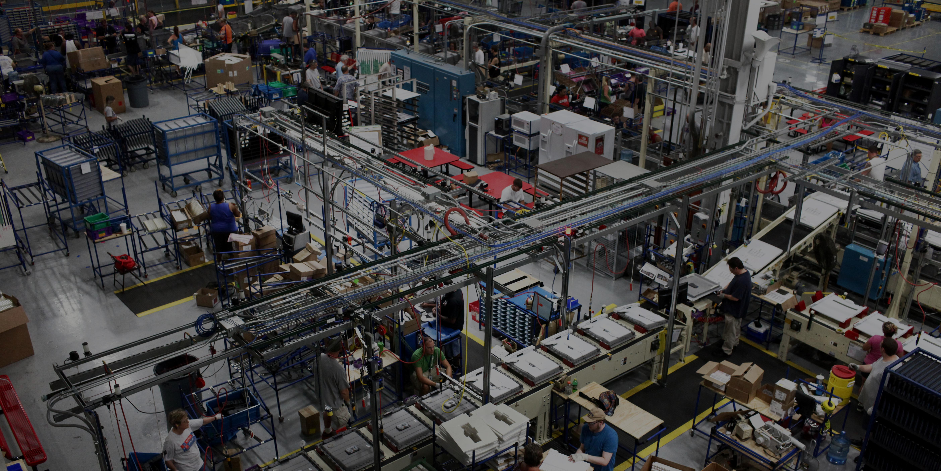

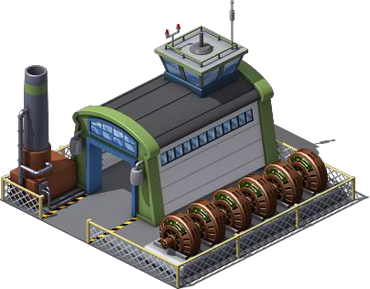
Devops: industrial it
Craftsmanship
Industrial

Slide 100



Devops components
Collaboration
of People
Convergence of Process
Creation & Exploitation of Tools

Slide 101
Devops component: People
Cultural Paradigm shift
Cross-training of skills
Collaboration and involvement of teams across all aspects of design.
Shared Responsibility.
Collaboration
of People
The question everyone should ask is “Is my application driving business value based on the state it is in now ?”

Slide 102
Devops component: process
Agile methodologies
Governance and continuous feedback loops to reduce/eliminate technical debt
Define metrics for measure
Inspired by Toyota Manufacturing Process.
Convergence of Process

Slide 103
Devops component: tool
Automation is key.
Standard environments: Development, Testing and Production.
Faster application environment provisioning, root cause analysis.
Creation & Exploitation of Tools
Continuous integration and delivering.

Slide 104
Devops: small chunks
JBoss
Monolith
Microservices

Slide 105


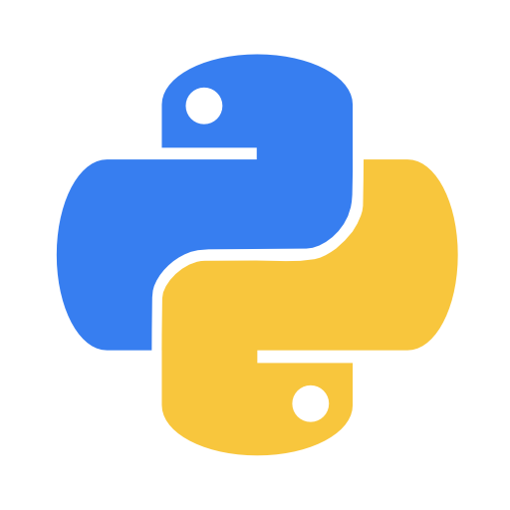


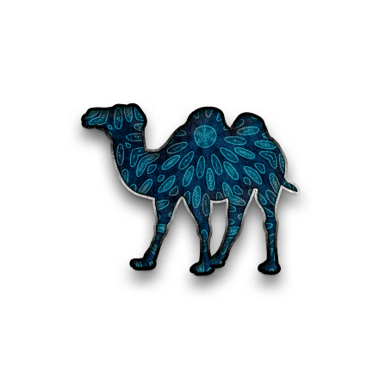


Devops: small chunks
java
8
senior
ruby
python
7
5.6.6
senior
middle
php
4.4.9
middle
.NET
perl
6
2.2.1
middle
junior
c
1.9.3
junior
Different languages
Different versions
Different
skills

Slide 106
Devops: small chunks
Speed of Deployment
Frequency of Deployments

Slide 107


Ability to respond to market needs
Testing
Improving
Monitor
Measuring

Slide 108


Faster Time-to-market
11.6
deployment/
second
1
1
deployment/
week
deployment/
month
1
deployment/
6 months

Slide 109
The goal
Rapid
Adaptation
Adaptative
Planning
Economic
Efficiency
Business
Agility
Focus on Time to Value
Low
Latency
Decoupling

Slide 110
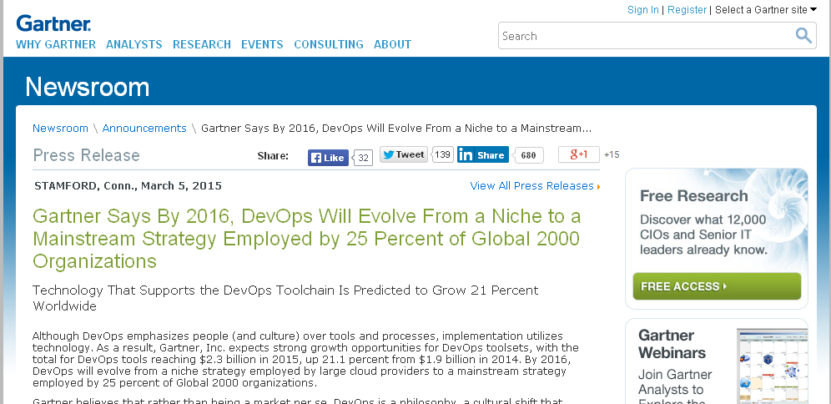
PRINTSCREEN GARTNER HERE
http://www.gartner.com/newsroom/id/2999017

Slide 111
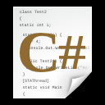







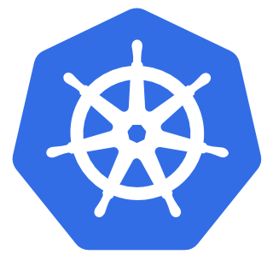
tooling
New Code
Analyze Results
GIT
Track all changes
Monitor
Testing Code
Containers
Host Factory

Slide 112
tooling
OpenShift

Slide 113

Howto: DEVelopment
OpenShift

Slide 114
District: DEV
REQUEST
New Code

Slide 115
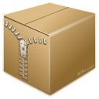
District: DEV
JBoss
http://myapp-hello.company.com
JBoss
(aprox 1 minute)
Configuration
ready
myapp-hello

Slide 116
District: DEV
JBoss
GIT PUSH
JBoss
Code Ready
myapp-hello
GIT

Slide 117

District: DEV
District: PROD
JBoss
JBoss
myapp-hello
myapp-hello
GIT
TEST PASSED

Slide 118
Howto: production
OpenShift

Slide 119
District: PROD
JBoss
http://myapp-hello.company.com
myapp-hello

Slide 120
District: PROD
JBoss
http://myapp-hello.company.com
myapp-hello

Slide 121
District: PROD
JBoss
RESPONSE: {“id”,”2”;”name”,”maltron”}
myapp-hello

Slide 122
District: PROD
JBoss
http://myapp-hello.company.com
myapp-hello

Slide 123
Scaling out
District: PROD
JBoss
JBoss
http://myapp-hello.company.com
myapp-hello

Slide 124
District: PROD
JBoss
JBoss
RESPONSE: {“id”,”2”;”name”,”maltron”}
myapp-hello

Slide 125
SCALing IN
District: PROD
JBoss
JBoss
http://myapp-hello.company.com
myapp-hello

Slide 126
District: PROD
JBoss
http://myapp-hello.company.com
myapp-hello

Slide 127
District: PROD
JBoss
RESPONSE: {“id”,”2”;”name”,”maltron”}
myapp-hello

Slide 128

Devops formula
New Tools
Change in Mindset

Slide 129
Red hat subscription
Legal Protection
Operation Man. Tool
Long-term Support
World Class Support
Knowledge Base
Security Patch
Change in Mindset

Slide 130

Red hat devops solution
Legal Protection
Operation Man. Tool
Long-term Support
assessment
World Class Support
consulting
Knowledge Base
Security Patch
mentoring
trainning
setup
discover
planning
architecture
building
monitoring
Professional Services

Slide 131



Professional services
Discovery Session
Workshops
Assessments
Implementation Sprints

